Slide 1
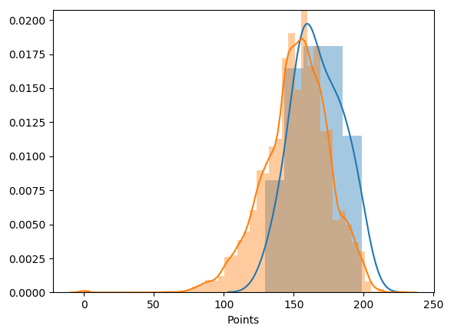
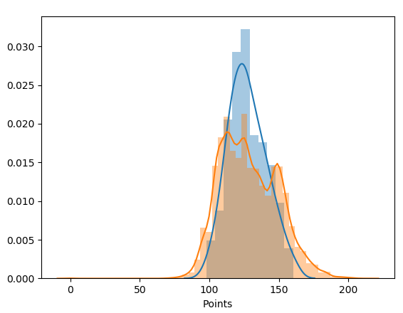
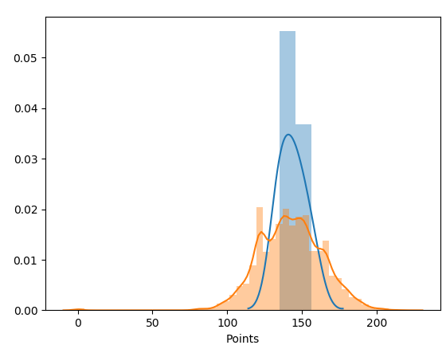
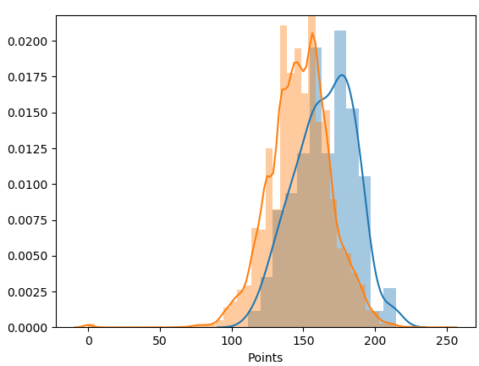
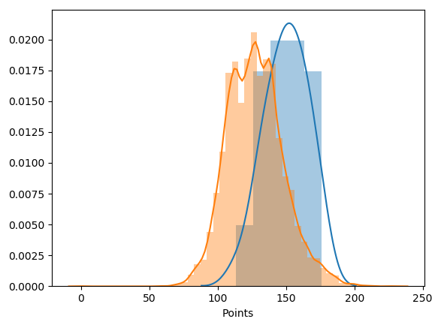
Ownership Match Stud Lock Strategy = 61.5% Average Return over 5 weeks: $100 → $123
Percent Of Generated Lineups that beat midpoint: 70.5%, 36.6%, 40%, 72.8%, 87.5%
10 lineups are more or less randomly selected from these generated lineups each week
Week 6
Week 7
Week 8
Week 9
Week 10

Slide 2
Investment = $100
Used Ownership Match Stud-Lock strategy with a lot of manual intervention
Week 6: $12
Week 7: $20
Week 8: $16
Week 9: $20
Week 10: $40
Return = $108 (54% success rate)

